Slide 1
ULMFiT for Text Classification Jeremy Howard and Sebastian Ruder https://arxiv.org/abs/1801.06146
Presented by:
Shadman Shoumik (45563659)
Shivani Kukreti (45666547)
Suchith Kumar Suresh (45502897)

Slide 2
INTRODUCTION
This research paper uses Transfer Learning that can be applied to any task in NLP.
It introduces a key for fine-tuning a language model.
The significant outcomes of this research reduced the error by 18-24% on the majority of the datasets.

Slide 3
ASPECTS
Using Fast.ai to replicate the code in the research paper which is a Python library containing some popular algorithms for image classification and natural language tasks
Uses pre-trained word embeddings (hypercolumns)
Classification type: Sentiment Analysis
Using the IMDb large movie review dataset containing 25,000 observations with 3 variables (label, text, is_valid)

Slide 4
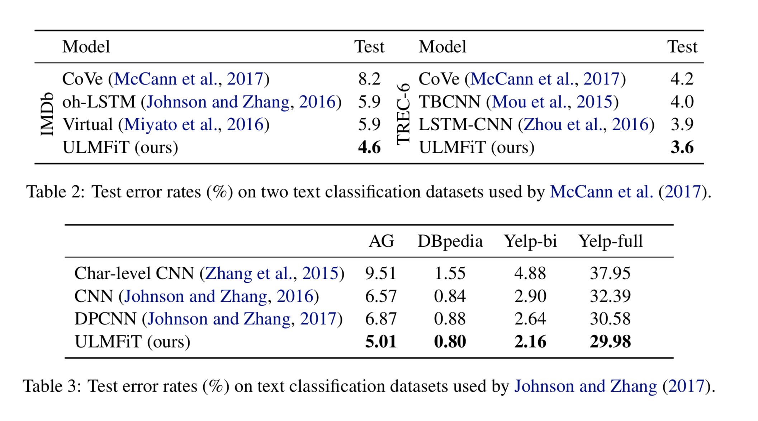
INDICATOR OF QUALITY
https://paperswithcode.com/paper/universal-language-model-fine-tuning-for-text: Table 2 & 3

Slide 5
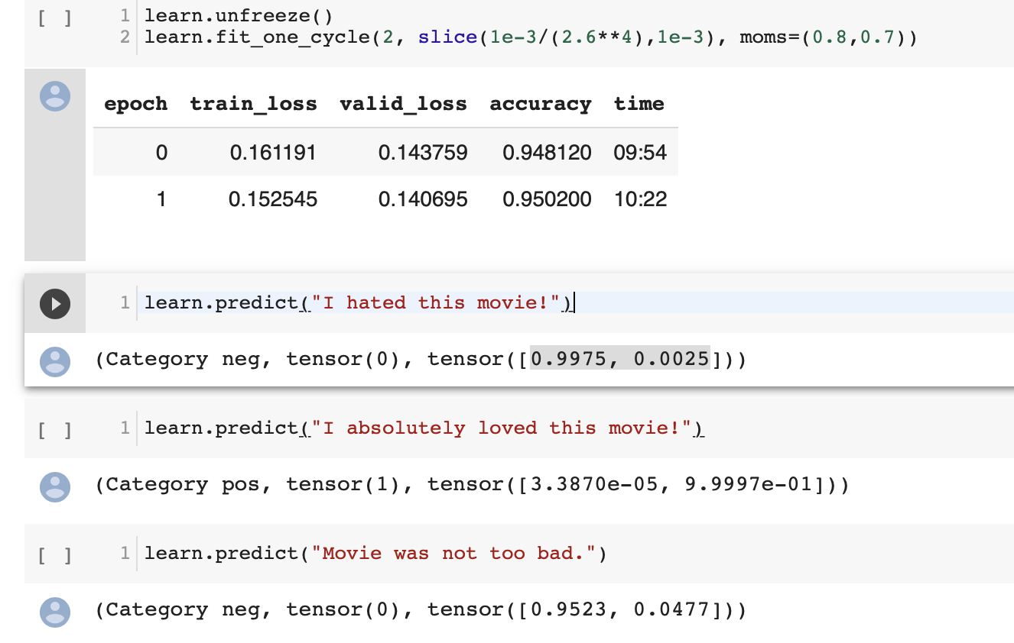
FEASIBILITY OF THE PROJECT
Is the code accessible?
https://paperswithcode.com/paper/universal-language-model-fine-tuning-for-text
Does it look likely to be able to be successfully implemented?
Have run the code in Colab and it ran successfully.
Is the original data actually available?
The original IMDb data is available at http://ai.stanford.edu/~amaas/data/sentiment/

Slide 6
NEW DATA CONSIDERTAION
Considering other data-sets containing reviews from different domains like:
Yelp
Zomato
Uber
Rotten Tomatoes

Slide 7
PROJECT PLAN
Update Presentation: Week 10
By Week 10, we’ll complete new dataset cleaning and manipulation
Build the language model and classifier
Final Presentation: Week 13
By week 13, run the necessary model tests and evaluate the model
Complete the report for review

Slide 8
THANK YOU

